Slide 1

Tutorial 5

Slide 2
Topic 1
Review four informal design guidelines for relational databases. Understand their rationales.

Slide 3
Topic 1
Review four informal design guidelines for relational databases. Understand their rationales.
1. Each tuple in a relation should represent one entity or relationship instance.
2. Design a schema that does not suffer from the insertion, deletion and update anomalies. If there are any anomalies present, then note them so that applications can be made to take them into account.
3. Relations should be designed such that their tuples will have as few NULL values as possible. Attributes that are NULL frequently could be placed in separate relations
4. The relations should be designed to satisfy the lossless join condition. No spurious tuples should be generated by doing a natural-join of any relations.

Slide 4
Topic 2
What is a functional dependency? Why can we not infer a functional dependency automatically from a particular relation state?

Slide 5

Topic 2
What is a functional dependency?
A functional dependency A->B in a relation holds if two tuples having the same value of attribute A also have the same value for attribute B.

Slide 6
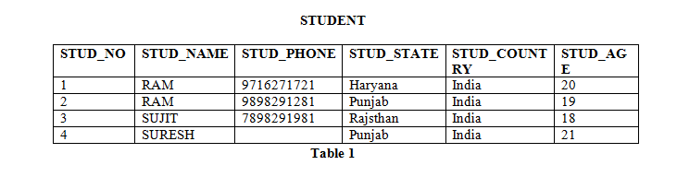
Topic 2
Find Functional Dependencies

Slide 7
Topic 2
Find Functional Dependencies
STUD_NO->STUD_NAME, STUD_NO->STUD_PHONE, STUD_NO->STUD_STATE, STUD_NO->STUD_COUNTRY and STUD_NO -> STUD_AGE
STUD_STATE->STUD_COUNTRY
STUDENT_COURSE, COURSE_NO->COURSE_NAME

Slide 8
Topic 2
Attribute Closure
Attribute closure of an attribute set can be defined as set of attributes which can be functionally determined from it.
(STUD_NO)+ = {STUD_NO, STUD_NAME, STUD_PHONE, STUD_STATE, STUD_COUNTRY, STUD_AGE}
(STUD_STATE)+ = {STUD_STATE, STUD_COUNTRY}

Slide 9
Topic 2
Attribute Closure
If attribute closure of an attribute set contains all attributes of relation, the attribute set will be super key of the relation.
If no subset of this attribute set can functionally determine all attributes of the relation, the set will be candidate key as well.

Slide 10
Topic 2
Attribute Closure
(STUD_NO, STUD_NAME)+ = {STUD_NO, STUD_NAME, STUD_PHONE, STUD_STATE, STUD_COUNTRY, STUD_AGE}
(STUD_NO)+ = {STUD_NO, STUD_NAME, STUD_PHONE, STUD_STATE, STUD_COUNTRY, STUD_AGE}

Slide 11
Topic 2
Exercise: Consider the relation scheme R = {E, F, G, H, I, J, K, L, M, N} and the set of functional dependencies {{E, F} -> {G}, {F} -> {I, J}, {E, H} -> {K, L}, K -> {M}, L -> {N} on R. What is the key for R?
{E,F}+ = {EFGIJ} {E,F,H}+ = {EFHGIJKLMN} {E,F,H,K,L}+ = {{EFHGIJKLMN} {E}+ = {E}
{EFH}+ and {EFHKL}+ results in set of all attributes, but EFH is minimal. So it will be candidate key.

Slide 12
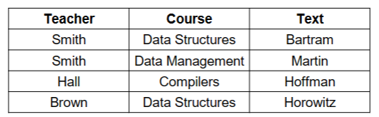
Topic 2
Why can we not infer a functional dependency automatically from a particular relation state?
Notes:
Incomplete Information: The current state of a relation may not represent all possible tuples that could exist within that relation. Functional dependencies are meant to be universally true, regardless of the current set of tuples.
Coincidental Truths: The data in a given state might accidentally comply with a certain dependency, but that compliance might not hold when new data is added or existing data is updated.
Misrepresentation of Business Rules: Functional dependencies are meant to model business rules or constraints that are inherent to the concepts being modeled, not to the particular instances of data currently in the database.
Assumption of Static Data: Inferring dependencies assumes that data is static and that the dependencies will continue to hold true as the database evolves, which is not generally the case.
Hidden Violations: Even if no violations of a potential functional dependency are visible in the current state, there may be unseen violations that could occur in other valid states of the relation.

Slide 13
Topic 3
Review 1NF, 2NF, 3NF and BCNF.
1NF (First Normal Form): A relation is in 1NF if it only contains atomic, indivisible values. There are no repeating groups or arrays.
2NF (Second Normal Form): A relation is in 2NF if it is in 1NF and all non-key attributes are fully functionally dependent on the primary key. This generally means removing partial dependencies of any column on the primary key.
3NF (Third Normal Form): A relation is in 3NF if it is in 2NF and all the attributes are functionally dependent only on the primary key.
BCNF (Boyce-Codd Normal Form): A relation is in BCNF if it is in 3NF and for every non-trivial functional dependency X→Y, X is a superkey. In simpler terms, BCNF is a more stringent version of 3NF.

Slide 14
Topic 3
Review 1NF, 2NF, 3NF and BCNF.
1NF: Atomic.
2NF: No Partial Dependency.
3NF: Informally, all attributes depend on nothing but the key
BCNF (Boyce-Codd Normal Form): A relation is in BCNF if it is in 3NF and for every non-trivial functional dependency X→Y, X is a superkey.

Slide 15
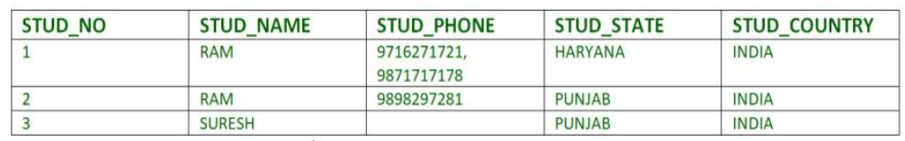
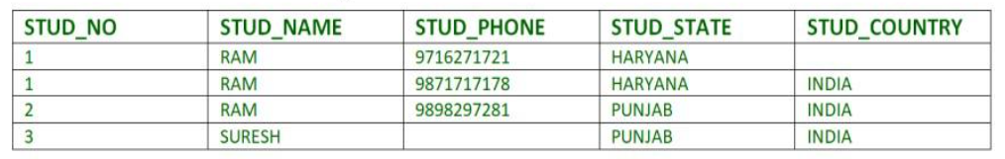

Slide 16
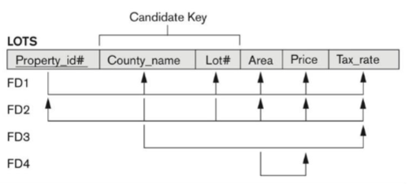

Slide 17
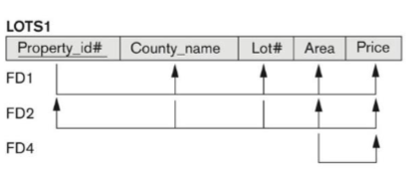
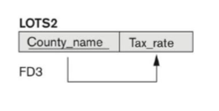

Slide 18
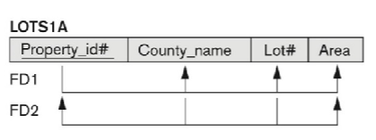
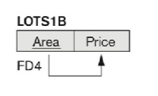

Slide 19
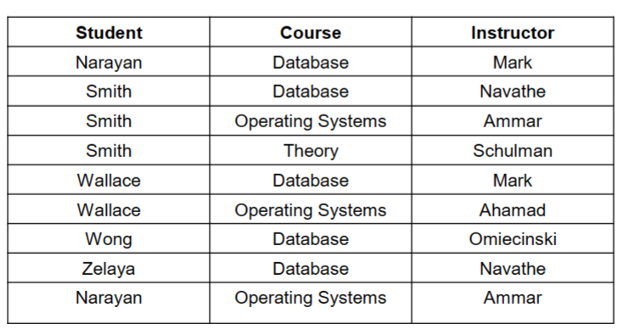
Notes:
(a) BCNF normalization of LOTS 1A with the functional dependency FD2 being lost in the decomposition. (b) A schematic relation with FDs; it is in 3NF, but not in BCNF due to the FD C→ B

Slide 20
A relation schema R is in third normal form (3NF) if every non-prime attribute in R meets both of these conditions:
▪It is fully functionally dependent on every key of R
▪It is non-transitively dependent on every key of R

Slide 21
Topic 3
Before Normalization:
Let's assume we have a table StudentCourses that looks like this:
StudentID | Courses | Grade | Teacher
1 | Math, Science | A | Mr. Smith
2 | Math, English | B | Mr. Smith
3 | Science, Art | A | Mrs. Johnson
Notes:
Issues:
Multiple courses are listed in a single field.
The Grade and Teacher are dependent not just on the StudentID but also on the Course.

Slide 22
Topic 3
1NF (First Normal Form)
In 1NF, each column should have atomic (indivisible) values. We can achieve this by splitting the courses into separate rows:
StudentID | Course | Grade | Teacher
1 | Math | A | Mr. Smith
1 | Science | A | Mr. Smith
2 | Math | B | Mr. Smith
2 | English | B | Mr. Smith
3 | Science | A | Mrs. Johnson
3 | Art | A | Mrs. Johnson
Notes:
2NF (Second Normal Form)
In 2NF, all non-key attributes must be fully functionally dependent on the primary key. In our case, let's assume that StudentID and Course together make the composite primary key. Grade and Teacher are dependent on both, so our table is already in 2NF.

Slide 23
Topic 3
3NF (Third Normal Form)
In 3NF, all attributes should be functionally dependent only on the primary key. Here, the Teacher is dependent on the Course, not directly on the primary key (StudentID, Course). To normalize this into 3NF, we remove the Teacher column and create a new table.
StudentID | Course | Grade
1 | Math | A
1 | Science | A
2 | Math | B
2 | English | B
3 | Science | A
3 | Art | A
Course | Teacher
Math | Mr. Smith
Science | Mrs. Johnson
Art | Mrs. Johnson
English | Mr. Smith
Notes:
Since all our non-trivial functional dependencies now have a superkey on the left-hand side, our design is already in BCNF.

Slide 24
Topic 4
What update anomalies occur in the
EMP_PROJ relation of Figures 14.3 and 14.4?
Notes:
In EMP_PROJ, the partial dependencies {SSN}->{ENAME} and {PNUMBER}->{PNAME, PLOCATION} can cause anomalies. For example, if a PROJECT temporarily has no EMPLOYEEs working on it, its information (PNAME, PNUMBER, PLOCATION) will not be represented in the database when the last EMPLOYEE working on it is removed (deletion anomaly). A new PROJECT cannot be added unless at least one EMPLOYEE is assigned to work on it (insertion anomaly).
Inserting a new tuple relating an existing EMPLOYEE to an existing PROJECT requires checking both partial dependencies; for example, if a different value is entered for PLOCATION than those values in other tuples with the same value for PNUMBER, we get an update anomaly.
Similar comments apply to EMPLOYEE information. The reason is that EMP_PROJ represents the relationship between EMPLOYEEs and PROJECTs, and at the same time represents information concerning EMPLOYEE and PROJECT entities.

Slide 25
Topic 5
Consider the universal relation R = {A, B, C, D, E, F, G, H} and the set of functional dependencies F = {{A, B}→{C}, {A}→{D, E}, {B}→{F}, {F}→{G, H}}. What is the key for R? Decompose R into 2NF and then 3NF relations.
Notes:
A minimal set of attributes whose closure includes all the attributes in R is a key.
Since the closure of {A, B}, {A, B}+ = R, one key of R is {A, B} (in this case, it is the only key).
To normalize R intuitively into 2NF then 3NF, we take the following steps:
First, identify partial dependencies that violate 2NF. These are attributes that are
functionally dependent on either parts of the key, {A} or {B}, alone. We can calculate the
closures {A}+ and {B}+ to determine partially dependent attributes:
{A}+ = {A, D, E}. Hence {A} -> {D, E} ({A} -> {A} is a trivial dependency)
{B}+ = {B, F, G, H}, hence {B} -> {F, G, H} ({B} -> {B} is a trivial dependency)
To normalize into 2NF, we remove the attributes that are functionally dependent on part
of the key (A or B) from R and place them in separate relations R1 and R2, along with
the part of the key they depend on (A or B), which are copied into each of these relations
but also remains in the original relation, which we call R3 below:
R1 = {A, D, E}, R2 = {B, F, G, H}, R3 = {A, B, C}
The new keys for R1, R2, R3 are underlined. Next, we look for transitive dependencies
in R1, R2, R3. The relation R2 has the transitive dependency {B} -> {F} -> {G, H}, so we
remove the transitively dependent attributes {G, H} from R2 into a relation R21 and copy the attribute F they are dependent on into R21. The remaining attributes are kept in a
relation R22. Hence, R2 is decomposed into R21 and R22 as follows:
R21 = {F, G, H}, R22 = {B, F}
The final set of relations in 3NF are {R1, R21, R22, R3}

